Slide 1
Student name: Jefferson Oliveira Lima Student number: 2020373
Data exploration and visualization

Slide 2
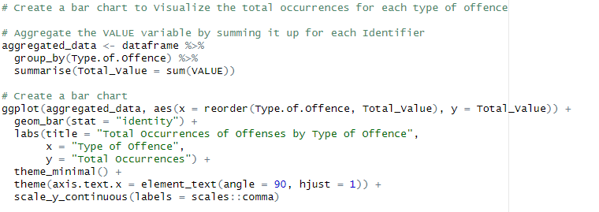
Bar chart total of occurrences
This code allows us to visually see a bar chart with the total of occurrences for each type of offense in a given dataset

Slide 3
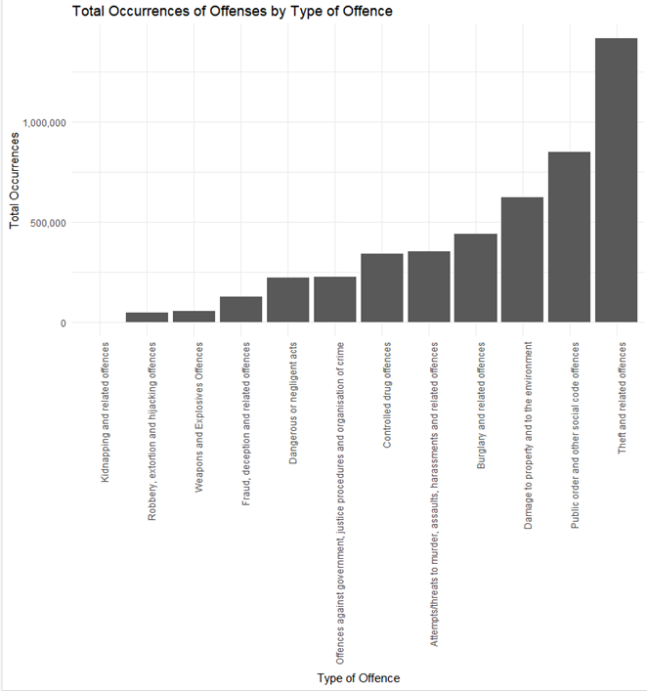
Bar chart total of occurences
This bar chart allows us to see Cleary which type of offences has occurred with more frequency

Slide 4
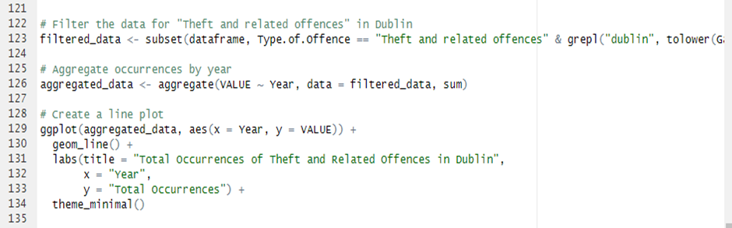
Data Exploratory Analysis
This code is involved with data filtering, aggregation and visualization

Slide 5
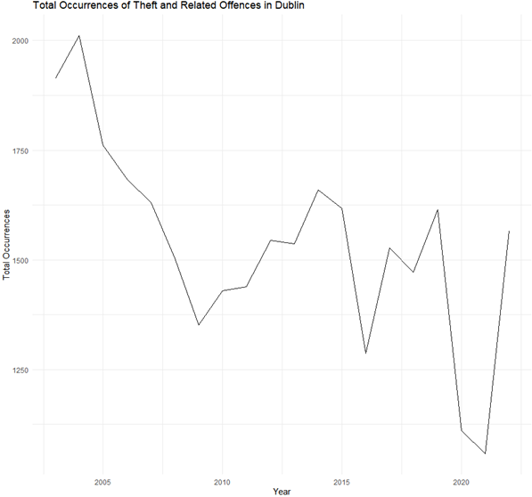
Data Exploratory Analysis
the code provided aligns to the principles of exploratory data analysis by filtering through relevant data, collecting information to emphasise patterns, and plotting the results to visually display the results

